Slide 1
Peer-graded Assignment Developing Computational Phenotyping Algorithm
This is a mandatory assignment to complete the Module 5,
Course 3 ‘Identifying Patient Populations’
Taught by
Laura K. Wiley, PhD, Associate Professor
Department of Biomedical Informatics
University of Colorado System
Palchamy Elango

Slide 2
Data Types – Identifying patients with hypertension
1. Gold standard hypertension dataset, (99 records)
cases 63, controls 36
2. ICD-9 Diagnosis Codes, excluded ICD-9 Medication. Queried the below IDs against DIAGNOSES_ICD dataset
401.0 (malignant), 401.1 (benign), or 401.9 (unspecified).
Found 38 subjects diagnosed with hypertension,
3. Searched the laboratory Data (LABEVENTS) for the following itemids. Observed missing data for LDL.
row_id ITEMID LABEL FLUID CATEGORY 105 50904 Cholesterol, HDL Blood Chemistry 2085-9 107 50906 Cholesterol, LDL, Measured Blood Chemistry 18262-6 108 50907 Cholesterol, Total Blood Chemistry 2093-3

Slide 3
Data Types – Manipulations of individual data types
Found 38 subjects diagnosed with hypertension in the DIAGNOSIS_ICD dataset.
Appended these records with the origin gold-standard hypertension data.
Gold-standard hypertension (manual review) | Hypertension | Freq
controls | 0 | 36
cases | 1 | 64
Diagnosis_ICD | Hypertension | Freq
controls | 0 | 61
cases | 1 | 38

Slide 4
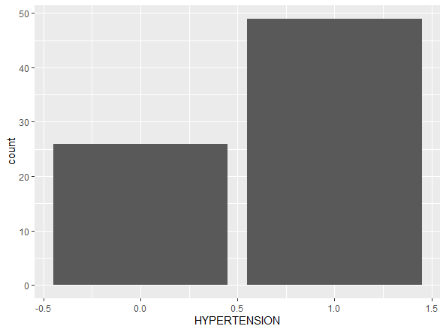
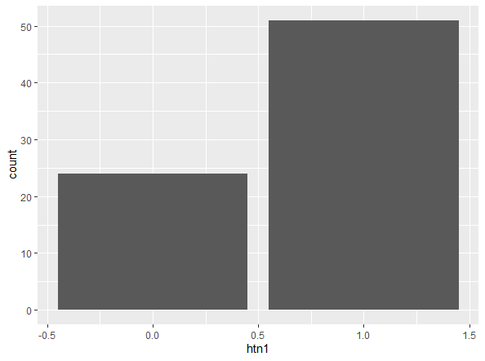
Manual Review (original) Hypertension | Original + ICD code + Lipid measures

Slide 5
Manual review data combined with ICD code
Confusion Matrix and Statistics
Accuracy : 0.6869
95% CI : (0.5859, 0.7764)
No Information Rate : 0.6364
P-Value [Acc > NIR] : 0.1739
Kappa : 0.4111
Mcnemar's Test P-Value : 1.629e-05
Sensitivity : 0.5556
Specificity : 0.9167
Pos Pred Value : 0.9211
Neg Pred Value : 0.5410
Prevalence : 0.6364
Detection Rate : 0.3535
Detection Prevalence : 0.3838
Balanced Accuracy : 0.7361
 |  | Manual Review of Hypertension
 |  | + | -
ICD Codes 401.0 401.1 401.9 | + | 35 | 3
 | - | 28 | 33

Slide 6
Data Types – Adding additional data types
Previous data (manual review + icd code) has been updated with Laboratory data.
Searched laboratory Data (LABEVENTS) for the following ITEMIDs
row_id ITEMID LABEL FLUID CATEGORY loinc_code 105 50904 Cholesterol, HDL Blood Chemistry 2085-9 107 50906 Cholesterol, LDL, Measured Blood Chemistry 18262-6 108 50907 Cholesterol, Total Blood Chemistry 2093-3 Filtered the data based on the following conditions:
Total cholesterol >=240 mg/dL HDL <35
LDL tests were missing in the laboratory data
Created ‘cholesterol’ datatype, and appended with the previous data,
New diagnosis variable ‘htn’ was derived based on other diagnosis columns, now the hypertension cases increased to 51

Slide 7
Manual review data combined with ICD code and Lab tests
Confusion Matrix and Statistics
Accuracy : 0.9733
95% CI : (0.907, 0.9968)
No Information Rate : 0.6533
P-Value [Acc > NIR] : 1.122e-11
Kappa : 0.94
Mcnemar's Test P-Value : 0.4795
Sensitivity : 1.0000
Specificity : 0.9231
Pos Pred Value : 0.9608
Neg Pred Value : 1.0000
Prevalence : 0.6533
Detection Rate : 0.6533
Detection Prevalence : 0.6800
Balanced Accuracy : 0.9615
'Positive' Class : 1
 |  | Manual Review of Hypertension
 |  | + | -
ICD Codes + Laboratory Lipid data | + | 49 | 2
 | - | 0 | 24

Slide 8
Conclusion
Adding additional data types increased both sensitivity and specificity.
Treatment (medication) datatype was not used, hence the specificity was marginally low.
Algorithm performance was very high, less complexity in implementations and the portability of the algorithm is moderate.

